Slide 1
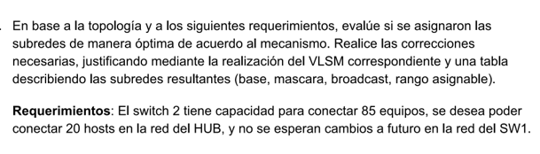
Requerimientos:
Switch2 = 85 + 2 = 87 -> 2^7 -2 -> 126
Hub = 20 + 2 = 22 -> 2^5 - 2 -> 30
Sw1 = 3 routers + 2 = 5 -> 2^3 -2 -> 6
Sw2 -> 192,168,0,0
Masc: 11111111, 11111111, 11111111,1/0000000
Salto: 256-128 = 128
Hub -> 192,168,0,128
Masc: 11111111, 11111111, 11111111,111/00000
Salto: 256 – 224 = 32
Hub -> 192,168,0,160
Masc: 11111111, 11111111, 11111111,11111/000
Salto: 256 – 248 = 8
Prox red 198,168,0,168

Slide 2
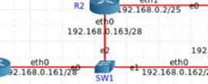
nombre
red
masc
primer
ultima
broad
sw2 | 192,168,0,0 | /25 | 192,168,0,1 | 192,168,0,126 | 192,168,0,127
hub | 192,168,0,128 | /27 | 192,168,0,129 | 192,168,0,158 | 192,168,0,159
sw1 | 192,168,0,160 | /29 | 192,168,0,161 | 192,168,0,166 | 192,168,0,167
0
128
160
168
sw1
/29
167
Hub /27
/28
Se asigno mal sw1.
Con un /29 alcanzaba.
(8 direcciones)
Sw2 /25
159
/26
127
256

Slide 3
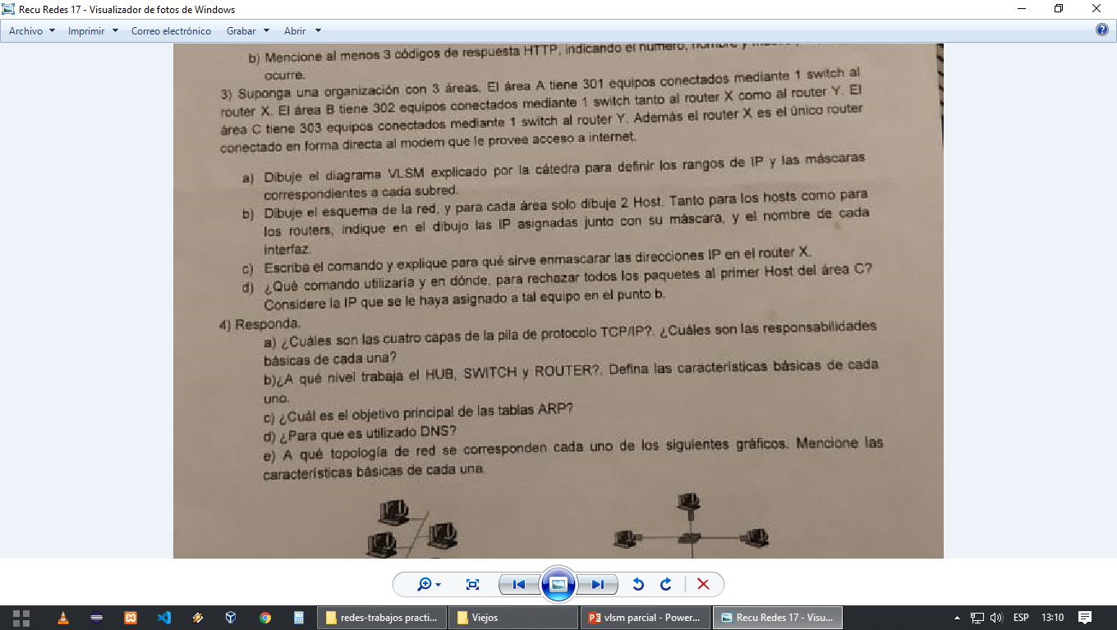
Área A
internet
Área B
192,0,0,0
301hosts
R X
302hosts
2^10 -2 = 1022
11111111,11000000.00000000.00000000
RY
Área C
303hosts

Slide 4
303 -> 2 ^ 9 -2 = 510
Nueva masc = 255,255,11111110,00000000
Salto = 256 – 254 = 2
192,2,0,0
302 -> 2^9 – 2 = 510
256-254 = 2
192,4,0,0
302 -> 2^9 – 2 = 510
256-254 = 2
nombre | SUB-RED | MASC | 1ERA UTILIZABLE | ULTIMA UTILIZABLE | BROADCASTS
Area C | 192.2.0.0 | /23 | 172.2.0.1 | 172.2.0.254 | 172.2.1.255
Area B | 192.2.2.0 | /23 | 192.2,2,1 | 192.2,3,254 | 192.2,3,255
Area A | 192.2.4.0 | /23 | 192.2,4,1 | 192.2,5,254 | 192.2,5,255

Slide 5
HOSTS | 256 | 128 | 64 | 32 | 16 | 8 | 4 | 2
MASC | /24 | /25 | /26 | /27 | /28 | /29 | /30 | /31
BIT | 0 | 1 | 2 | 3 | 4 | 5 | 6 | 7
BITS | 8 | 7 | 6 | 5 | 4 | 3 | 2 | 1
SUB RED | 0 | 2 | 4 | 8 | 16 | 32 | 64 | 128

